Slide 1
SW
Programming 2 Project
20175157 조성민

Slide 2
01. Checking Files

Slide 3
01.
Checking Files
Using this function
long _findfirst( char *filespec, struct _finddata_t *fileinfo );
int _findnext( long handle, struct _finddata_t *fileinfo );
int _findclose( long handle );

Slide 4
02. Finding Keyword

Slide 5
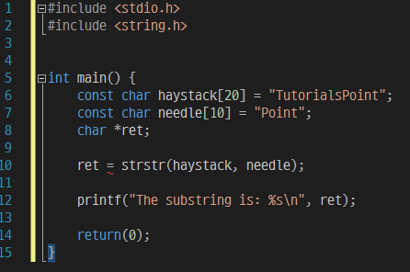
02.
Finding Keyword
Using strstr function
Function finds the first occurrence of the
Substring needle in the string haystack
char *strstr(const char *haystack, const char *needle)

Slide 6
03. Ranking

Slide 7
03.
Ranking
Keyword frequency
Similarity of words
Blank next to Keyword

Slide 8
Thank you

